Slide 1
Radio Wave Propagation & Propagation Path-loss Models

Slide 2
Basics - Propagation
Radio waves are
Easy to generate
Can travel long distances
Can penetrate buildings
They are both used for indoor and outdoor communication
They are omni-directional: can travel in all directions
Properties of radio waves are frequency dependent
At low frequencies, they pass through obstacles well, but the power falls off sharply with distance from source
At high frequencies, they tend to travel in straight lines and bounce of obstacles (they can also be absorbed by rain)
They are subject to interference from other radio wave sources

Slide 3
Mobile Radio Propagation Effects
Signal strength
Must be strong enough between base station and mobile unit to maintain signal quality at the receiver
Must not be so strong as to create too much co-channel interference with channels in another cell using the same frequency band.
Fading
Signal propagation effects may interrupt the signal and cause errors

Slide 4
Radio Wave Propagation Mechanisms
The physical mechanisms that govern radio propagation are complex and diverse, but generally attributed to the following three factors,
Reflection
Diffraction
Scattering

Slide 5
Contd.
Reflection
When a radio wave propagating in one medium impinges upon another medium having different electrical properties, the wave is partially reflected and partially transmitted.
Fresnel Reflection Coefficient (Γ) gives the relationship between the electric field intensity of the reflected and transmitted waves to the incident wave in the medium of origin
The Reflection Coefficient is a function of the material properties, depending on
Wave Polarization
Angle of Incidence
Frequency of the propagating wave

Slide 6
Contd.
Diffraction
Occurs when the radio path between sender and receiver is obstructed by an impenetrable body and by a surface with sharp irregularities (edges).
Radio signal can propagate around the curved surface of the earth, beyond the horizon and behind obstructions.
Explains how radio signals can travel urban and rural environments without a line-of-sight path
Scattering
Occurs when the radio channel contains objects whose sizes are on the order of the signal wavelength and also when the number of obstacles are quite large.
They are produced by small objects, rough surfaces and other irregularities on the channel
Follows same principles with diffraction
Causes the transmitter energy to be radiated in many directions
Lamp posts and street signs may cause scattering

Slide 7
Contd.
R
transmitter
Street
S
D
D
Building Blocks
R: Reflection
D: Diffraction
S: Scattering
receiver

Slide 8
Radio Propagation Models
In generic system studies, the mobile radio channel is usually evaluated from 'statistical' propagation models: no specific terrain data is considered, and channel parameters are modeled as stochastic variables. Three mutually independent, multiplicative propagation phenomena can usually be distinguished:
Multipath propagation Fading leads to rapid fluctuations of the phase and amplitude of the signal if the vehicle moves over a distance in the order of a wave length or more. Multipath fading thus has a 'small-scale' effect.
Shadowing This is a 'medium-scale' effect: field strength variations occur if the antenna is displaced over distances larger than a few tens or hundreds of metres.
Path loss The 'large-scale' effects cause the received power to vary gradually due to signal attenuation determined by the geometry of the path profile in its entirety. This is in contrast to the local propagation mechanisms, which are determined by terrain features in the immediate vicinity of the antennas.

Slide 9
Multipath Reception
The mobile or indoor radio channel is characterized by 'multipath reception':
The signal offered to the receiver contains not only a direct line-of-sight radio wave, but also a large number of reflected radio waves.
Even worse in urban centers, the line-of-sight is often blocked by obstacles, and a collected of differently delayed waves is all what is received by a mobile antenna.
These reflected waves interfere with the direct wave, which causes significant degradation of the performance of the link.
If the antenna moves the channel varies with location and time, because the relative phases of the reflected waves change. This leads to fading:
Time variations of the received amplitude and phase.

Slide 10
Models for multipath reception
The following models mostly address the channel behavior at one frequency only.
Rayleigh models
Rician models

Slide 11
Path Loss
Path loss models describe the signal attenuation between a transmit and a receive antenna as a function of the propagation distance and other parameters.
Path loss (or path attenuation) is the reduction in power density (attenuation) of an electromagnetic wave as it propagates through space.
Path loss models are used to estimate the received signal level as a function of distance.
With the help of this model we can predict SNR for a mobile communication system.

Slide 12
Contd.
Propagation models are used to determine the number of cell sites required to provide coverage for the network.
Initial network design typically is based on coverage.
Later growth is engineered for capacity.
Some systems may need to start with wide area coverage and high capacity and therefore may start at a later stage of growth.
The coverage requirement along with the traffic requirement relies on the propagation model to determine the traffic distribution, and will offload from an existing cell site to new cell sites as part of a capacity relief program.

Slide 13
Contd.
The propagation model helps to determine where the cell sites should be placed to achieve an optimal location in the network.
If the propagation model used is not effective in placing cell sites correctly, the probability of incorrectly deploying a cell site in the network is high.
The performance of the network is affected by the propagation model chosen because it is used for interference predictions.
The propagation model is also used in other system performance aspects including handoff optimization, power level adjustments, and antenna placements.

Slide 14
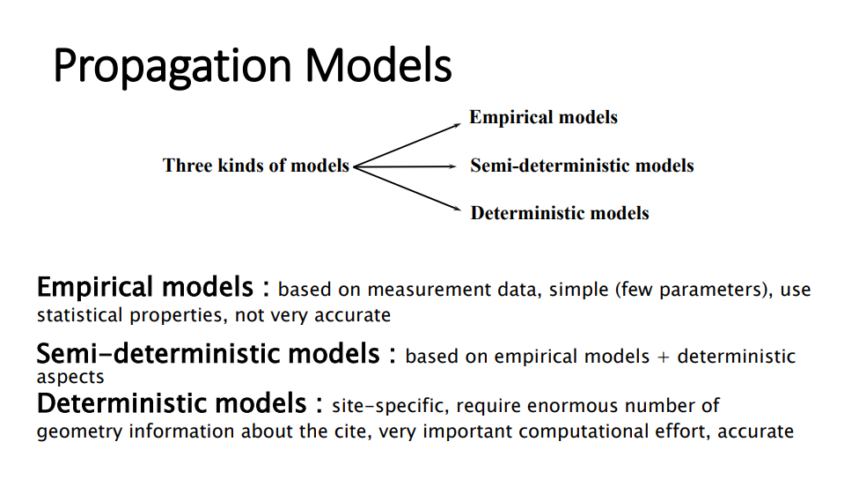

Slide 15
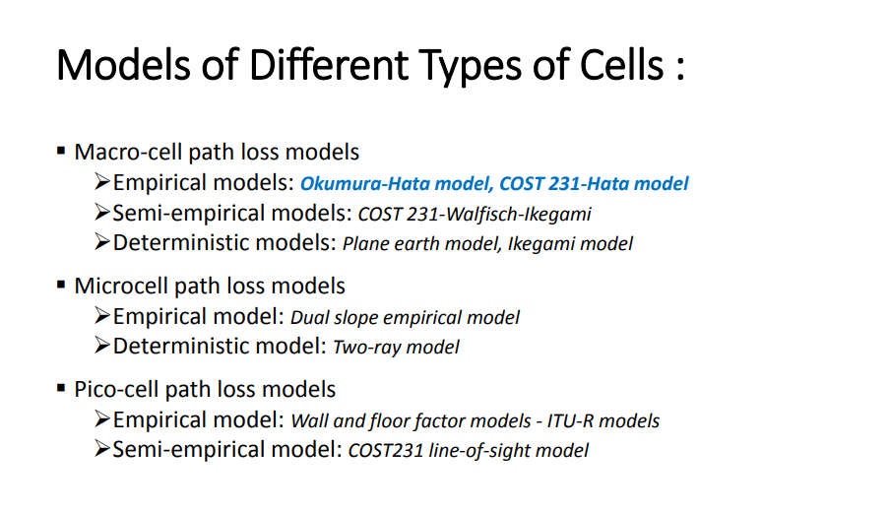

Slide 16
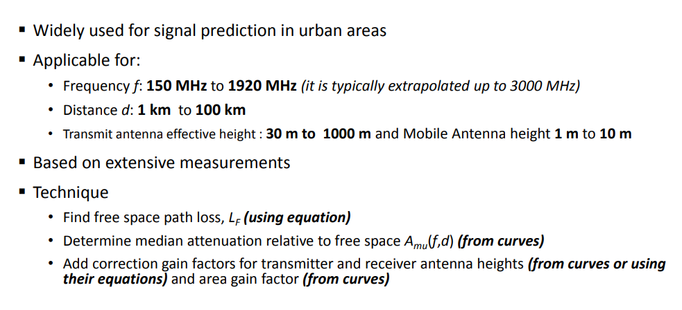
Okumura Model

Slide 17
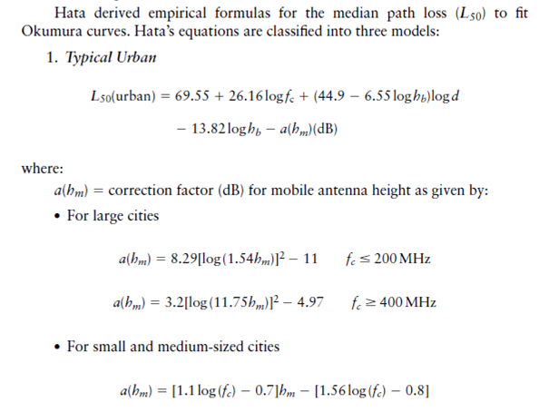
Contd.

Slide 18
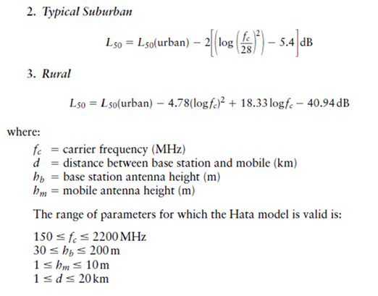
Contd.

Slide 19
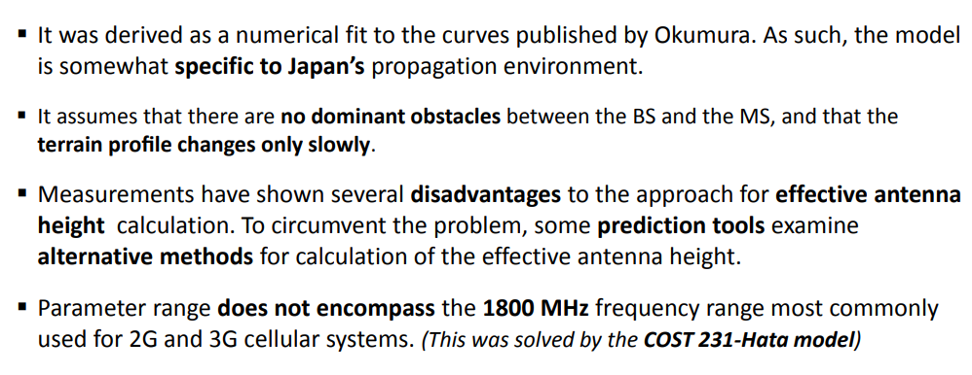
Okumura-Hata Model (Pros and Cons)

Slide 20
Cost 231 Model
This model is a combination of empirical and deterministic models for estimating the path loss in an urban area over the frequency range of 800 MHz to 2000 MHz.
The model is used primarily in Europe for the GSM 1800 system.

Slide 21
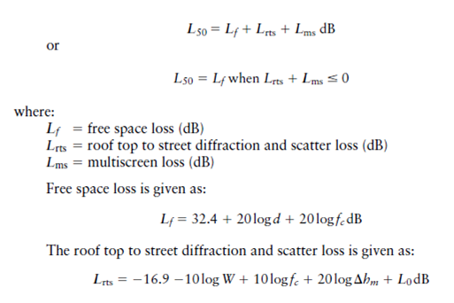
Contd.

Slide 22
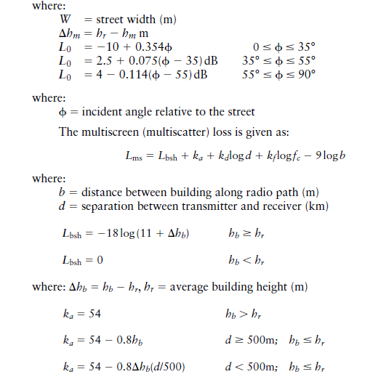
Contd.

Slide 23
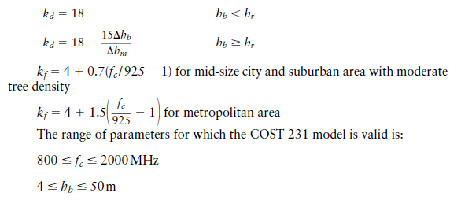
Contd.

Slide 24
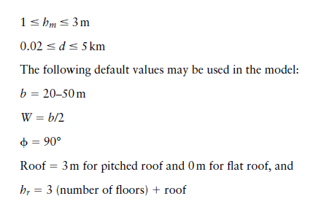
Contd.

Slide 25
Contd…
Path loss normally includes
Propagation losses :
by the natural expansion of the radio wave front in free space (which usually takes the shape of an ever-increasing sphere),
Absorption losses / penetration losses:
when the signal passes through media not transparent to electro magnetic wave
Diffraction losses :
when part of the radio wave front is obstructed by an opaque obstacle, and losses caused by other phenomena.

Slide 26
Contd…
Two such models
Log - Distance Path Loss Model
Log - Normal Shadowing
Several path loss models have been proposed, for instance:
Egli's model
Okumura's model
Hata's model
COST 231 - Hata

Slide 27
THE END

